Slide 1
Project:
Securing the Perimeter
Osman Mohammed:
03/31/2024

Slide 2
Section 1
Designing a Secure Network Architecture

Slide 3
Section 1: Designing the Network
Time to tackle XYZ's perimeter challenges. You've identified that the first thing to do is design a secure network architecture for XYZ. XYZ has provided you a list of business requirements so you can get started on designing a secure layout. Your first task is to incorporate all the requirements securely in a network design.
Use https://app.diagrams.net/ to design a secure network architecture.
Include and label the following requirements in your design:
1) An on-premise network that has 3 workstations in it.
2) A Virtual Network with the following segments:
Public DMZ with two web servers and a load balancer in it.
Private DMZ with two database servers.
Management LAN with one management server in it.
Internal LAN with 5 workstations in it.
Private Secure LAN with 3 database servers.
Additionally include the following:
1) A VPN gateway connecting the on-premise network to your Virtual Network.
2) Show placement of security devices in the architecture, including load balancer(s), firewall(s), IDS/IPS device(s).
3) Show the flow of traffic, and remember to incorporate best security practices with the flow of traffic between the different subnets.

Slide 4
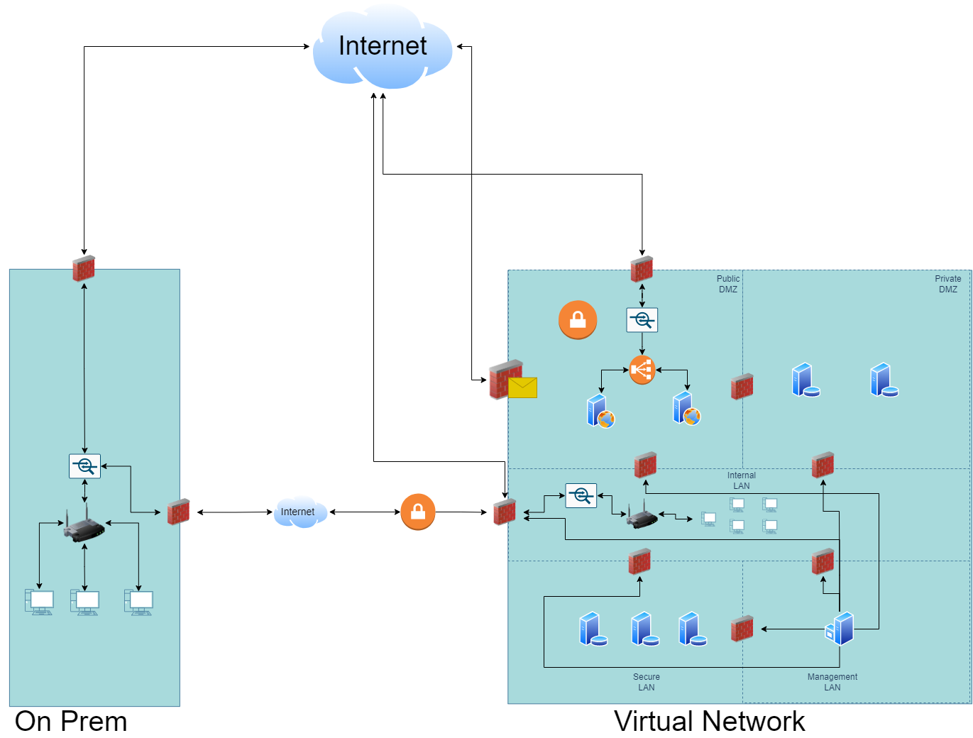
1.1 Designing the Network
Paste your Network Diagram here:
Remove this slide

Slide 5
Section 2
Building a Secure Network Architecture
in Azure

Slide 6
Section 2: Building the Network
After designing the network architecture, you now present your design to XYZ's stakeholders. They're all on board with your design, and have given you the green light to start building the architecture out in Azure.
So your next task is to go the Project Workspace in the classroom, and build out the enterprise network in Azure!
If you are accessing Azure with the Udacity classroom workspace, there will be a Resource Group in Azure called ‘entp-project’ that has already been created for you.
If you are accessing Azure using your own Azure account, first of all you should create a resource group called ‘entp-project’.
This ‘entp-project’ resource group is where you will create all the components that make up this project. When creating VMs in this section, please only use Standard_B1s for your VM size and the Linux Ubuntu 18.04 image.
Insert screenshots of your network on the following pages, showing completion of each of the specified tasks.

Slide 7
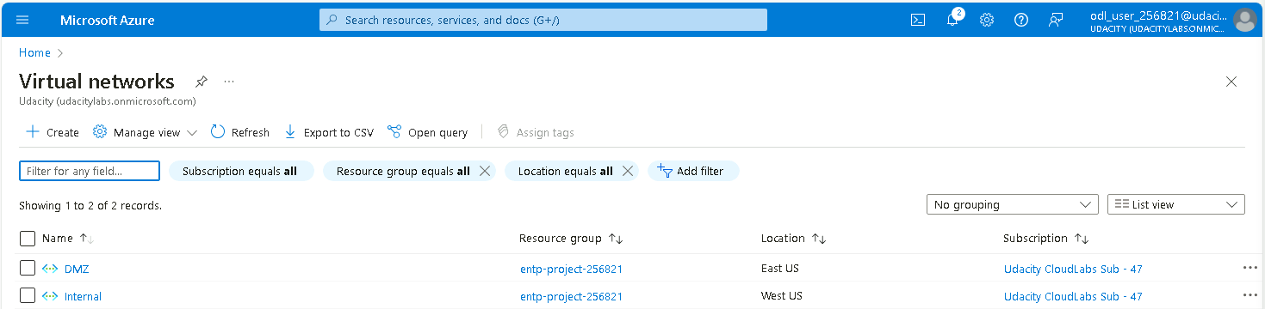
2.1.1 Screenshot
Create two Azure Virtual Networks in the resource group ‘entp-project’. Label one for your DMZ and one as your Internal.

Slide 8
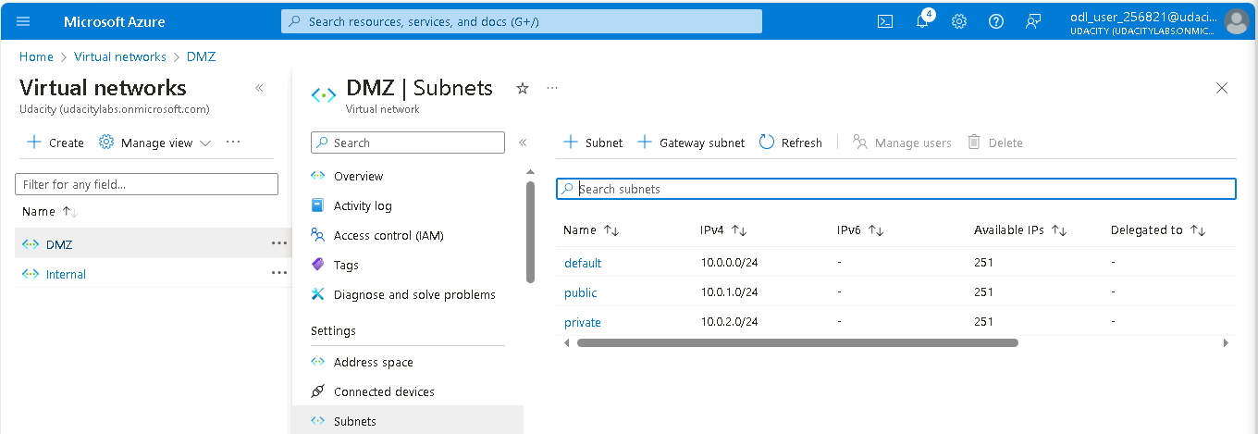
2.1.2 Screenshot
Create 2 subnets within your DMZ - subnets should be public and private.

Slide 9
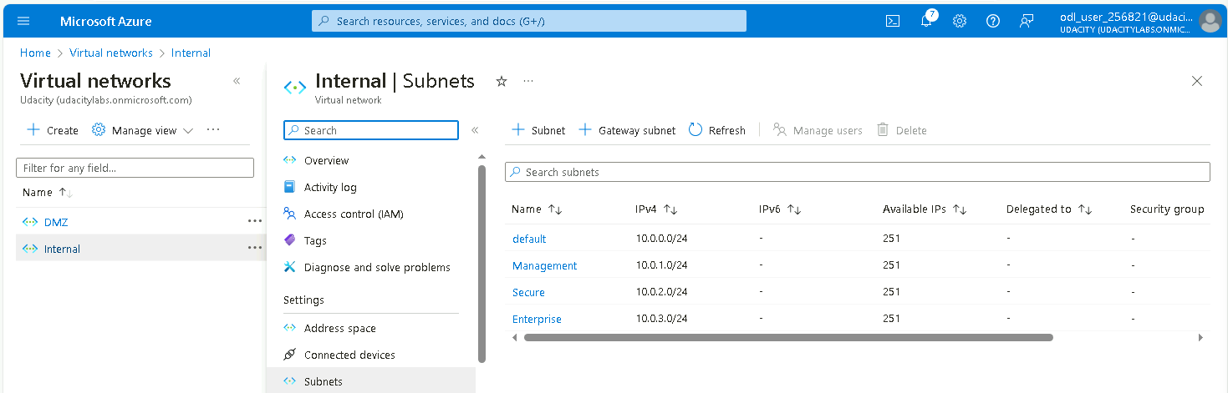
2.1.3 Screenshot
Create three subnets in your internal network and label them Management, Secure, and Enterprise.

Slide 10
2.2 Creating Virtual Machines
In this next section you will create Virtual Machines in your subnets. You will create 2 VMs in your DMZ and 3 VMs in your internal network. Please only use the Standard_B1s VM size and the Linux Ubuntu 18.04 image.
Insert screenshots on the following pages, showing completion of each of the specified tasks.

Slide 11
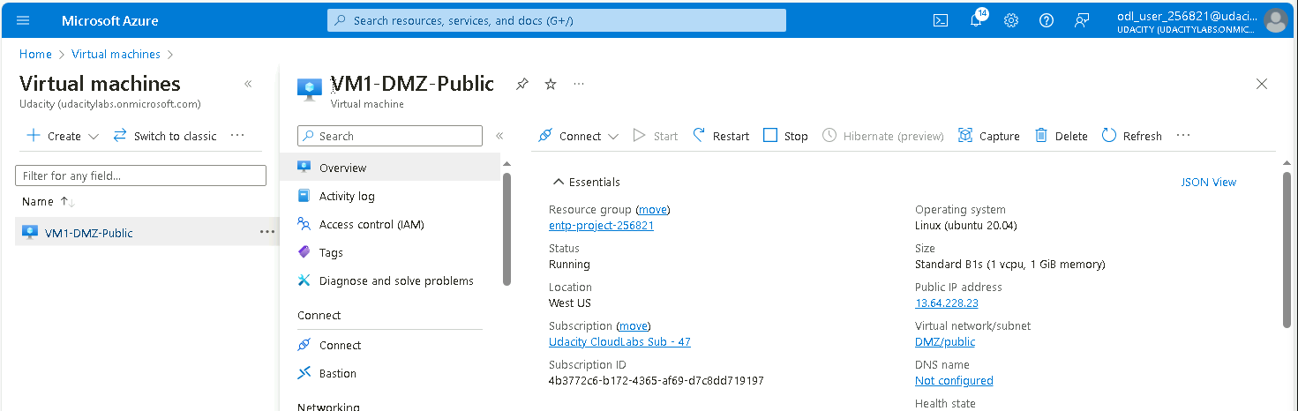
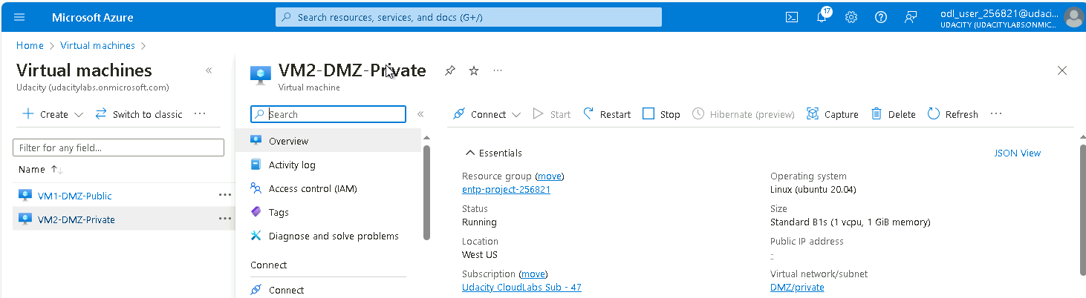
2.2.1 Screenshot
Create one VM in each of your public and private DMZ subnets. Please only use Standard_B1s for your VM size and select the Linux Ubuntu 18.04 image, otherwise you will encounter an error.

Slide 12
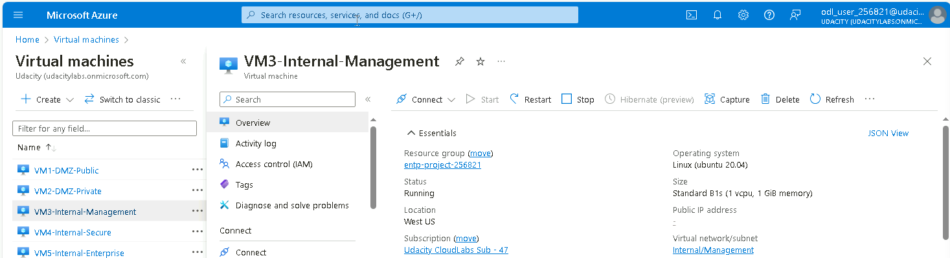
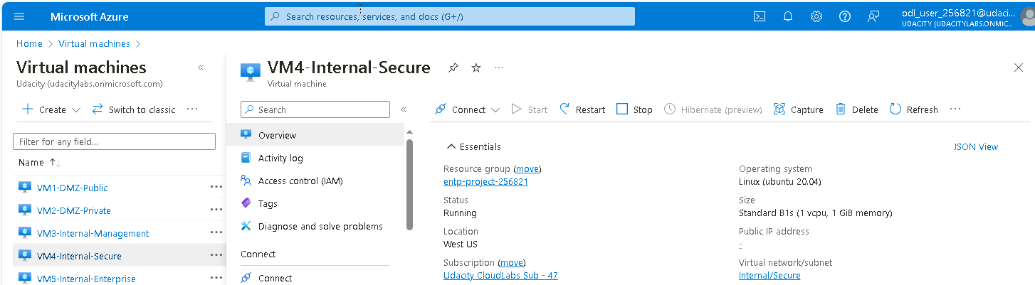
2.2.2 Screenshot
Create one VM in each of your Management, Secure, and Enterprise internal subnets. Please only use Standard_B1s for your VM size and select the Linux Ubuntu 18.04 image, otherwise you will encounter an error.

Slide 13
2.3 Secure Routing
In this next section you will configure secure routing within your Virtual Network and subnets. Follow secure best practices when creating network traffic rules.
Insert screenshots on the following pages, showing completion of each of the specified tasks.

Slide 14
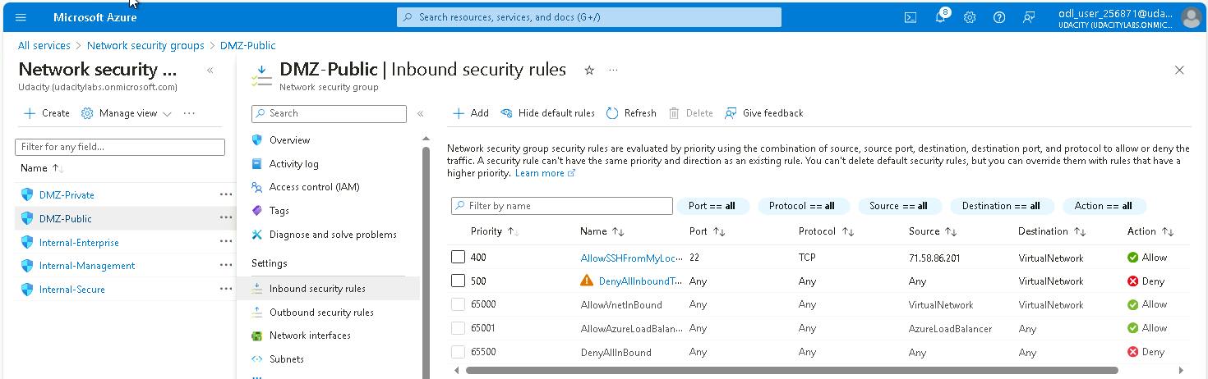
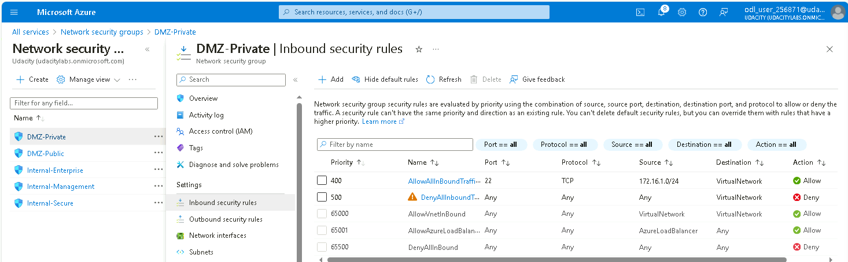
2.3.1 Screenshot
Traffic rules in your DMZ.
DMZ - Public
DMZ - Private

Slide 15
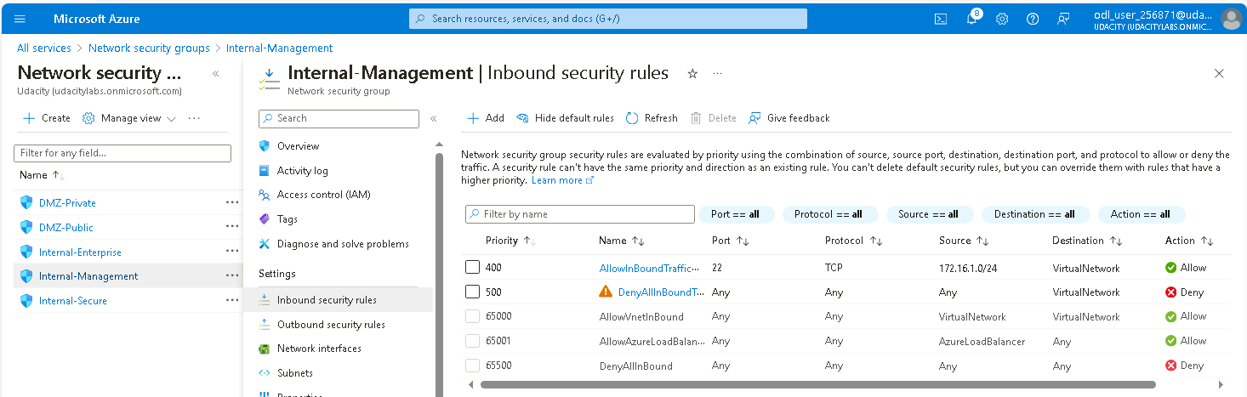
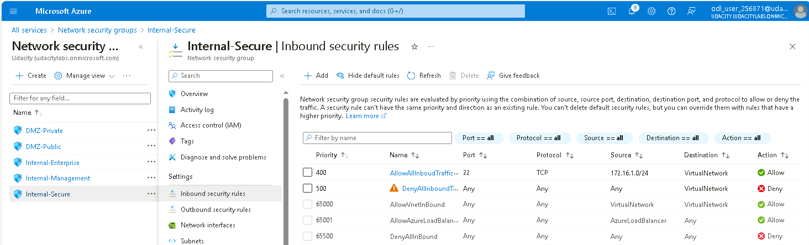

2.3.2 Screenshot
Traffic rules in your Internal network.
Internal - Management
Internal - Secure
Internal - Enterprise

Slide 16
2.4 VPN Access
In this next section you will create a VPN to secure access to your internal network. After creating your VPN, test your VPN connection and attempt connecting to one of your VMs in your internal network.
Insert screenshots on the following pages, showing completion of each of the specified tasks.

Slide 17
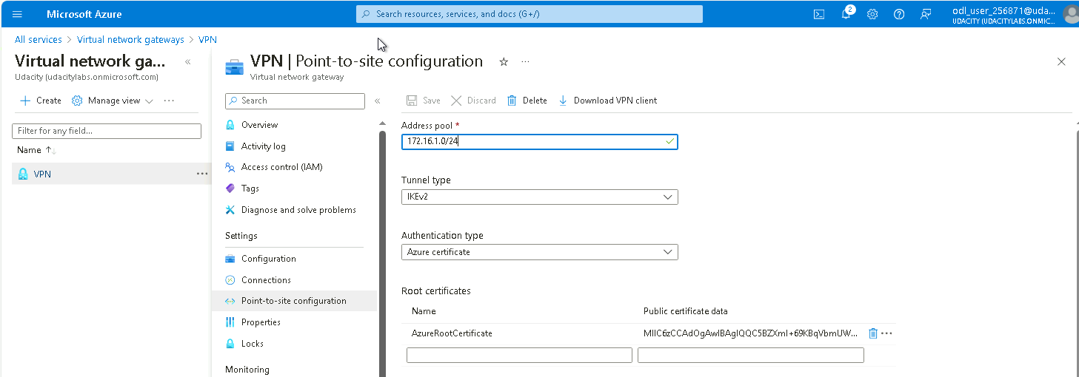
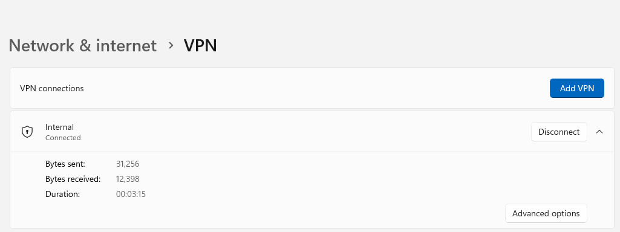
2.4.1 Screenshot
Create a VPN to connect to your internal network.

Slide 18
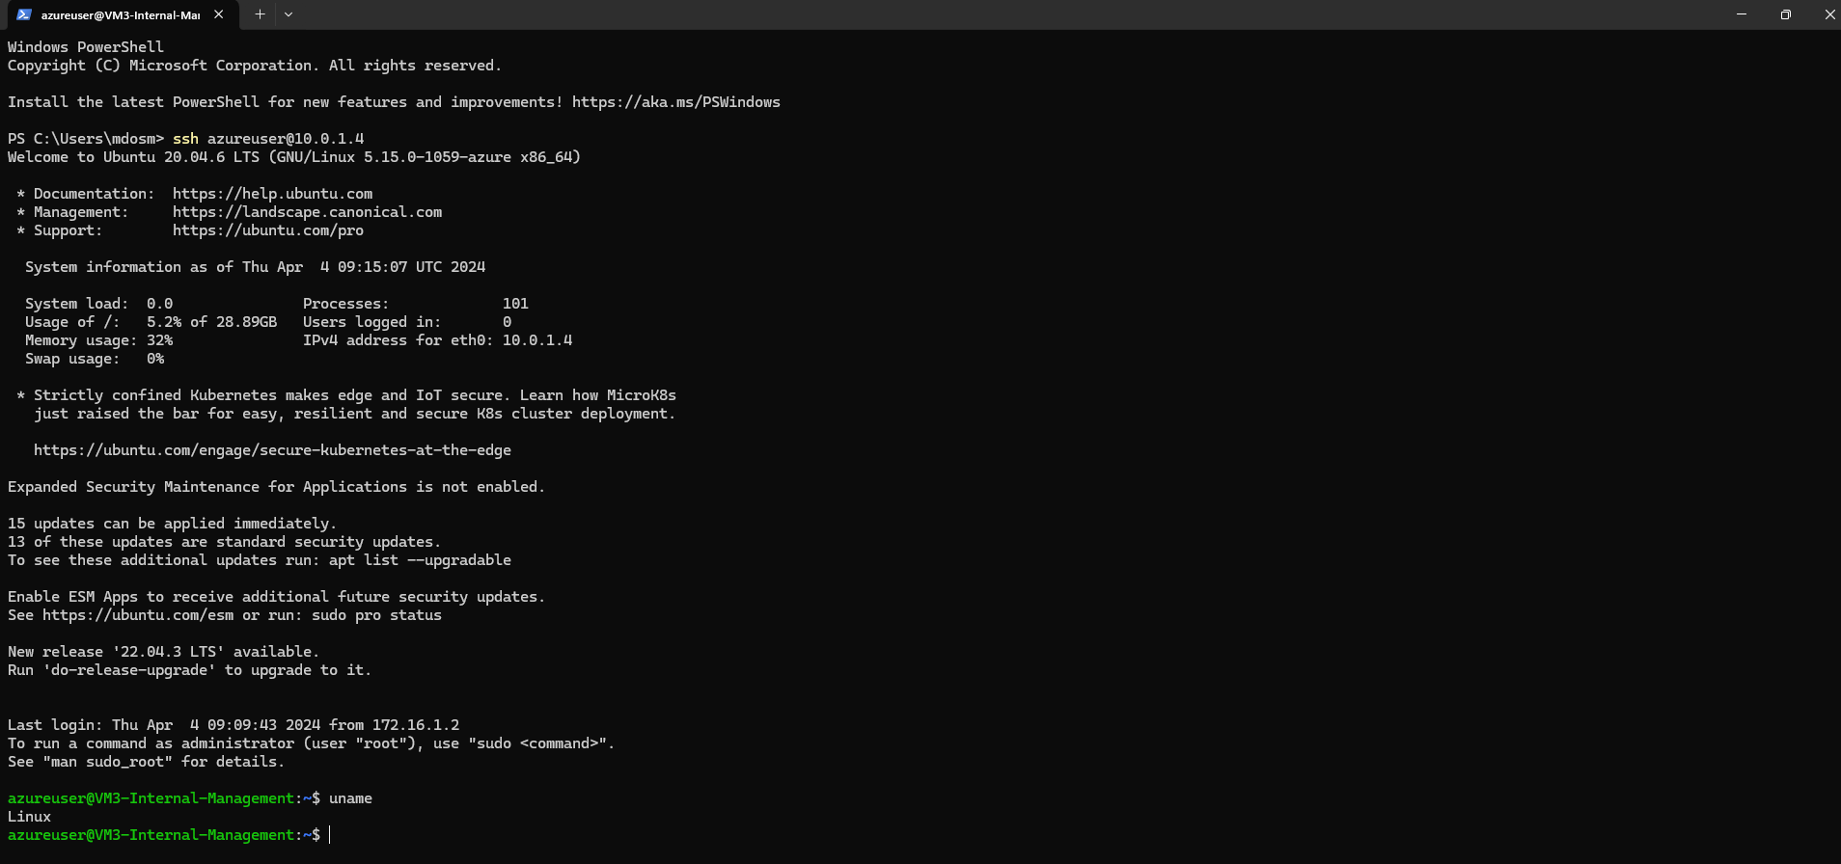
2.4.2 Screenshot
Test VPN connection by connecting to one of the VMs in your internal network.

Slide 19
Section 3
Continuous Monitoring with a SIEM

Slide 20
Section 3: Build the SIEM
Now that you've built a secure network architecture and a Zero Trust model, you're ready to wrap up your contract and finish the last piece of work. Your last task is to set up a solution to monitor the enterprise network and alert you about potential attacks.
For this section, you will continue working in the Project Workspace in the classroom, then provide screenshots of your work here in this document.
Insert screenshots on the following pages, showing completion of each of the specified tasks.

Slide 21
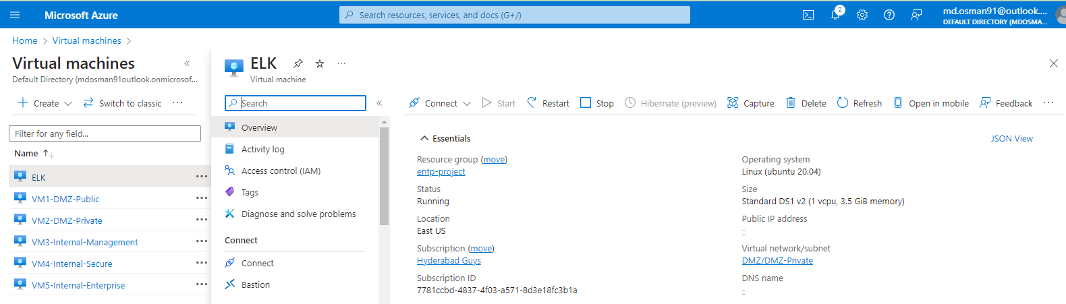
3.1.1 Screenshot
Create a VM in your private DMZ. On that VM, go through the process to create an ELK Server. For your Elk Server use the VM size DS1_v2 and Linux Ubuntu 18.04 image.

Slide 22
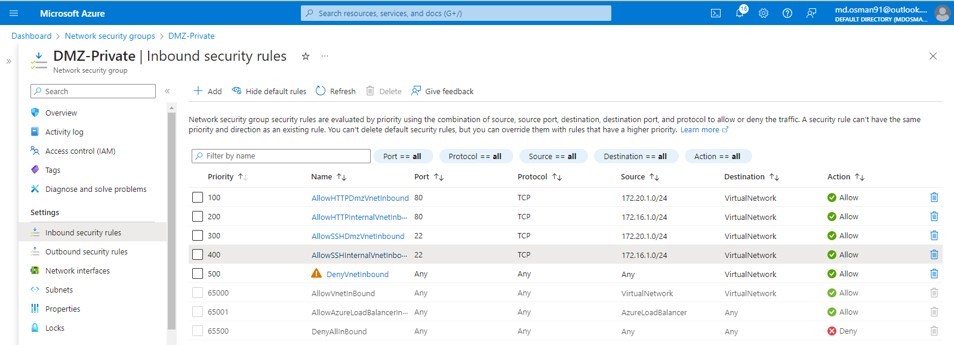
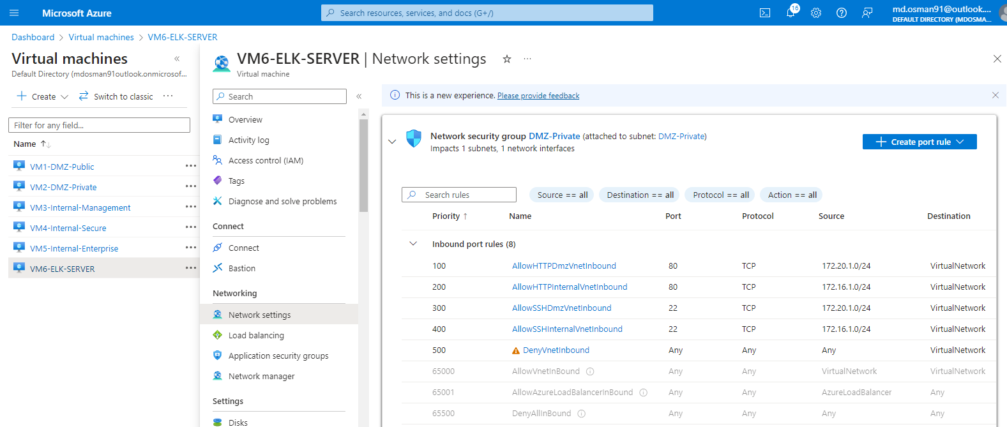
3.1.2 Screenshot
Set up routing to only allow traffic inbound to the server from both your virtual networks, and make sure Kibana is only accessible when you're on the network.

Slide 23
3.2 Ingest Logs
In this next section, you will start setting up ingest sources for your ELK server.
Insert screenshots on the following pages, showing completion of each of the specified tasks.

Slide 24
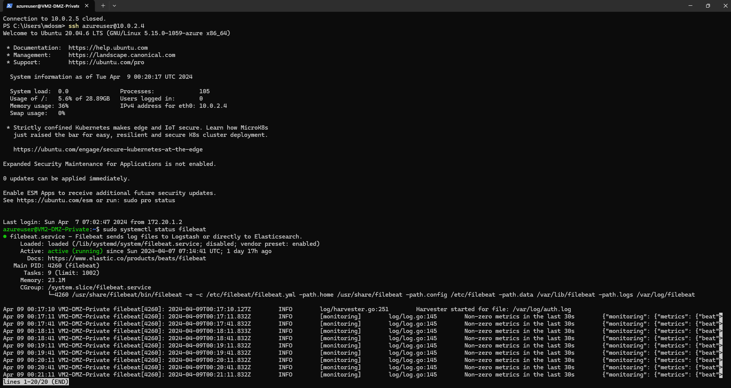
3.2.1 Screenshot
Install Filebeat on your web servers and show the Filebeat service as active.

Slide 25
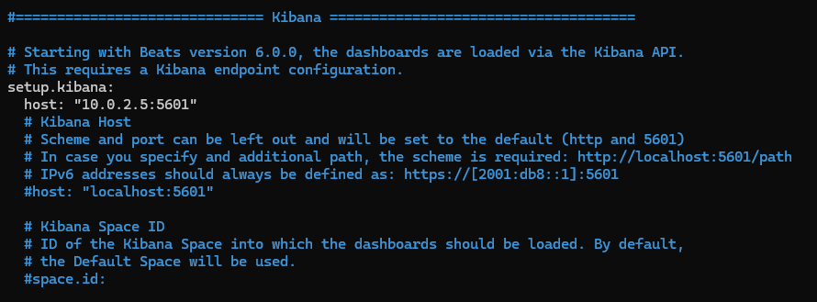
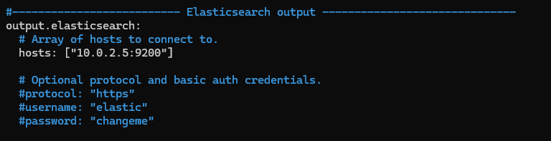
3.2.2 Screenshot
Configure Filebeat to route web server logs to Elasticsearch.

Slide 26
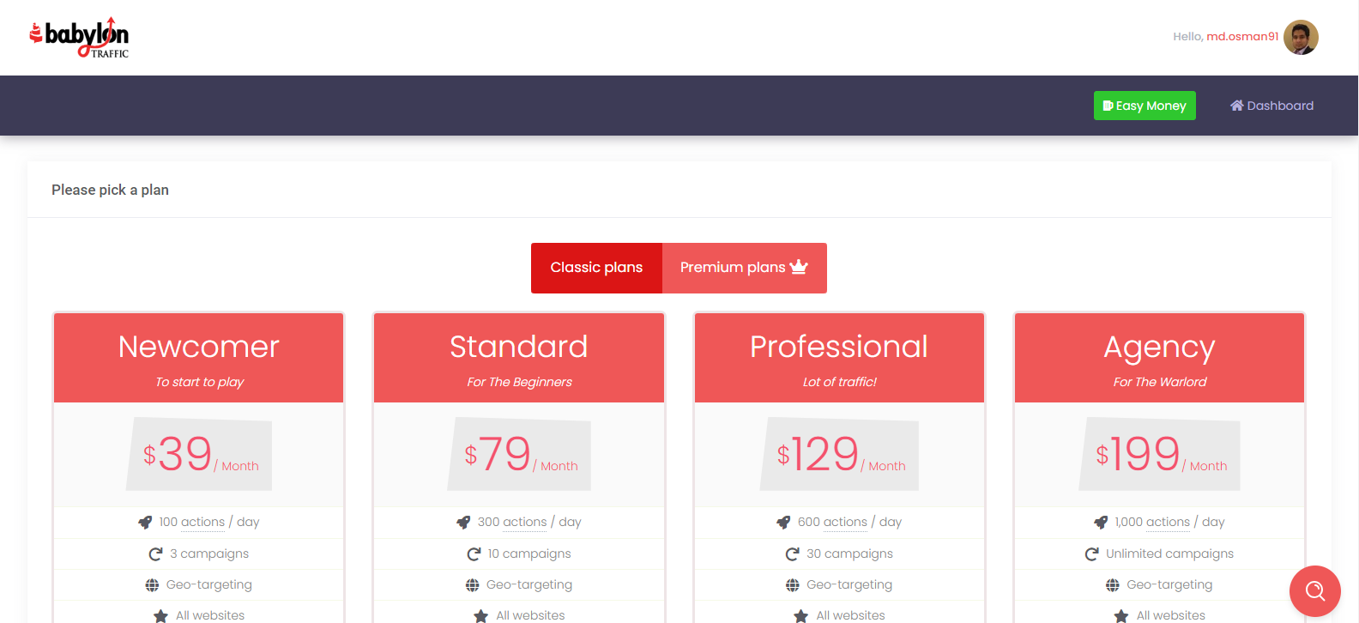
3.2.3 Screenshot
Simulate web traffic to your web servers using https://www.babylontraffic.com.
I tried sending traffic to web servers using the above URL, but it asks me for a payment.
I did using Apache as shown in the course work.

Slide 27
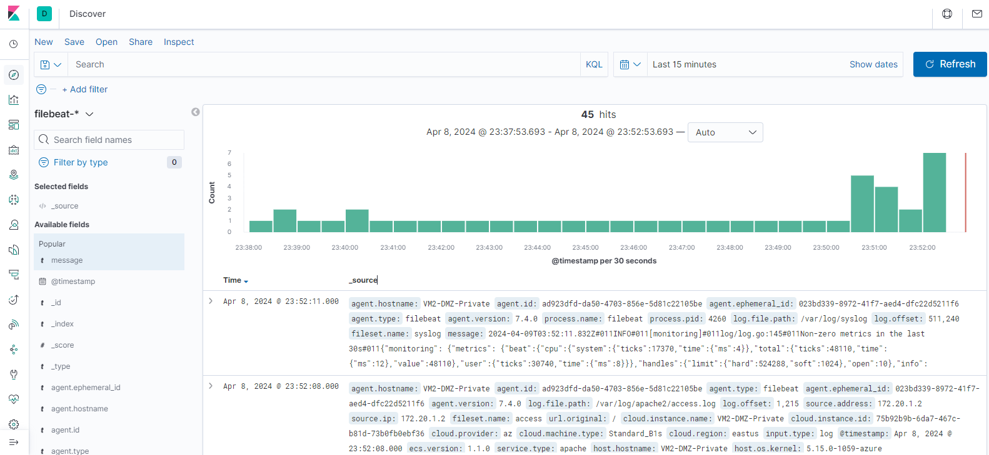
3.2.4 Screenshot
Web server logs appear in Kibana.

Slide 28
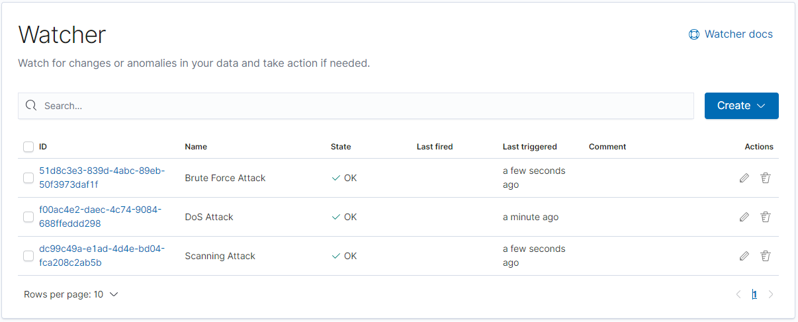
3.3 Build Alerts
In this next section, you will create alerts on the simulated web traffic you see. Build alerts to alert you of possible DoS, brute force, and probing attacks.
Insert screenshots on the following pages, showing completion of each of the specified tasks.

Slide 29
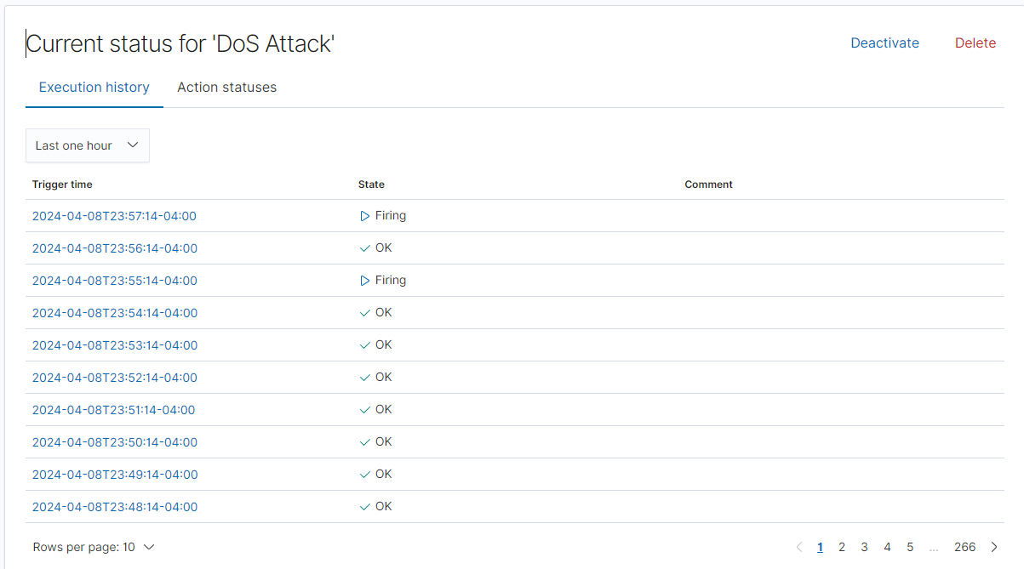
3.3.1 Screenshot
Create an alert for DoS attack.
Definition
A denial-of-service (DoS) attack is a cyber attack that prevents a device from functioning normally by overwhelming it with requests.
My approach to creating the alert
I Created this alert based on HTTP status code. For example, if there are more than 10 requests per minute to our Apache server, the alert will fire. This approach represents the mindset behind creating the alert. Since this is my first time using ELK Stack, I don’t have the expertise to create advanced alerts, like checking conditions like whether we are getting multiple requests from the same source, failed login attempts, or scanning open ports.

Slide 30
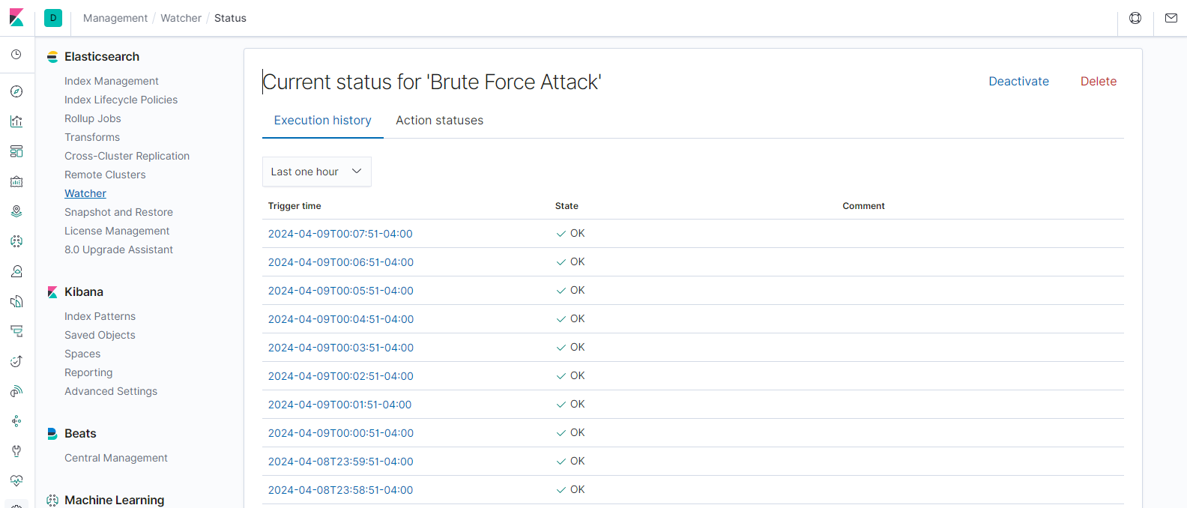
3.3.2 Screenshot
Create an alert for Brute Force attack.
Definition
A brute force attack is a hacking method that uses trial and error to gain unauthorized access to systems and networks. Hackers use brute force attacks to crack passwords, encryption keys, API keys, and SSH logins. The attack involves guessing information, such as usernames and passwords until the hacker guesses correctly. Brute force attacks are simple and reliable, but they can take anywhere from seconds to years to crack a password, depending on the length and complexity.
My approach to creating the alert
Same explain as above.

Slide 31
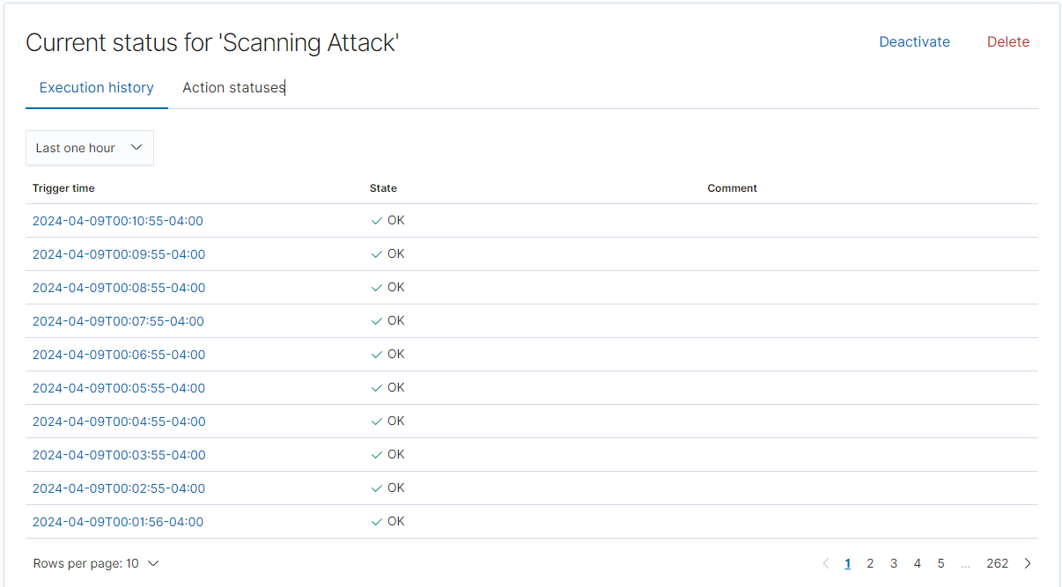
3.3.3 Screenshot
Create an alert for a scanning attack. During the scan, an attacker is looking to identify what ports are open.
Definition
A scanning attack involves trying to find vulnerabilities or weaknesses in a computer system or network by searching for open ports, services, or other entry points. The attacker typically uses special tools and software to do this.
My approach to creating the alert
Same explain as above.

Slide 32
3.4 Incident Response Playbook
Write a playbook below, detailing what the set of steps would be in response to each of the alerts you created in the last section 4.3. Add more pages if you need.
DoS Attack Playbook
Preparation
Plan ahead by ensuring the infrastructure can handle spikes in traffic.
Keep contact information for your ISP and hosting provider updated for quick communication.
Set up a communication bridge using a platform unaffected by the attack.
Ensure incident analysis resources are available, like traffic analysis tools.
Conduct user training on identifying and reporting potential DoS symptoms.
Regularly patch systems and network equipment to mitigate known vulnerabilities.
Detection & Analysis
Analyze logs for sudden spikes in traffic and error rates.
Use monitoring tools to identify the source and type of traffic.
Configure alerts for traffic volume thresholds to detect potential DoS activity.
Prioritize the incident based on impact and communicate to the team.
Containment, Eradication, and Recovery
Implement containment strategy by using rate limiting or temporarily blocking IPs.
Work with your ISP to reroute or block malicious traffic upstream.
Gather evidence from logs and monitoring tools for further analysis.
Identify attacker details if possible, noting attack vectors used.
Restore services following the containment, monitoring for stability.
Post-Incident Activity
Conduct a lessons learned meeting to review the attack and response effectiveness.
Use the information gathered to improve defenses and response strategies.
Retain incident evidence with detailed documentation for future reference.

Slide 33
Brute Force Attack Playbook
Preparation
Plan for account security measures like lockouts after several failed attempts.
Keep an updated list of emergency contacts for IT security personnel.
Establish clear communication channels for reporting suspected brute force incidents.
Ensure tools for monitoring login attempts and account access are in place.
Train users in creating strong, unique passwords.
Regularly update and patch authentication systems and services.
Detection & Analysis
Analyze authentication logs for failed login attempts that exceed normal patterns.
Utilize monitoring tools to flag repetitive access requests from the same IPs.
Set alerts for multiple failed login attempts within a short timeframe.
Document the incident with specific details on targeted accounts and systems.
Containment, Eradication, and Recovery
Temporarily disable affected accounts to stop the attack.
Change credentials for compromised accounts and strengthen password requirements.
Scan for any other signs of system compromise and take corrective actions.
Reinstate accounts with heightened monitoring for suspicious activity.
Post-Incident Activity
Review the brute force attempt to identify any weaknesses in security practices.
Update security measures, like adding CAPTCHA or implementing two-factor authentication.
Archive all evidence and documentation related to the incident.

Slide 34
Scanning Attack Playbook
Preparation
Prepare by ensuring network monitoring systems are in place to detect scanning.
Maintain updated contact lists for network security teams.
Establish a communication plan to notify stakeholders of potential breaches.
Have incident response tools ready for network traffic analysis.
Educate users on recognizing unusual system or network behavior.
Keep security devices like firewalls and intrusion detection systems updated.
Detection & Analysis
Analyze firewall and IDS logs for unusual patterns that indicate scanning.
Leverage monitoring tools to detect scans and pinpoint their origin.
Set up alerts for scan signatures, such as sweeps or port scans.
Document the scanning attempt, noting which systems were targeted.
Containment, Eradication, and Recovery
Block the IP addresses involved in scanning at the firewall level.
Review system and application logs for any signs of successful breaches.
Ensure that all systems are patched against known vulnerabilities.
Monitor network activity post-incident to ensure no further suspicious behavior.
Post-Incident Activity
Hold a lessons learned meeting to discuss the scanning attack and response.
Implement changes to improve detection and defense based on the incident findings.
Securely store all related logs and documentation for legal or educational purposes.
These playbooks are structured to provide a thorough response to each alert, ensuring your team is prepared to handle these types of security incidents effectively. Remember to regularly review and practice these playbooks to stay prepared for real-world attacks.

Slide 35
Section 4
Designing a
Zero Trust Model

Slide 36
Section 4: Zero Trust Model
XYZ is elated with the work you've done so far! But they've been hearing about this new buzzword "Zero Trust" and are curious as to what it is and what the architecture would look like in a Zero Trust model. So your next task below is to design a Zero Trust model, then explain the differences between your network architecture and your Zero Trust model.
Design a Zero Trust model of your network architecture using https://app.diagrams.net/.
Make sure to incorporate the following into your design:
- Identity
- Devices
- Apps
- Network
- Data
- Infrastructure
- Trusted and Untrusted Devices
- Controls

Slide 37
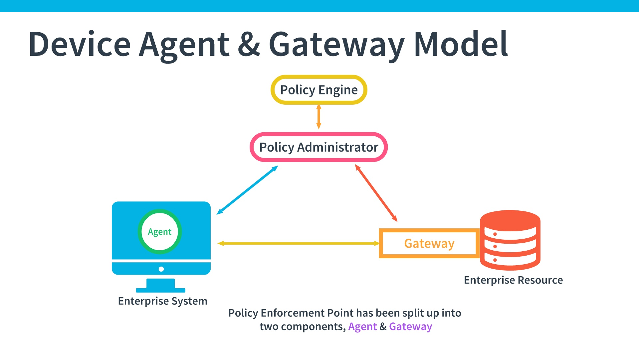
4.1 Zero Trust Model
Paste your Zero Trust model diagram here:
As I learned in the course, I prefer the Device Agent & Gateway model for implementation in an enterprise. With this model, I believe you get the most visibility on the state of all requesting systems and are able to continuously control access. The limitations of this model are that it requires an agent on every system, and it can be hard to implement BYOD, but I believe these are marginal tradeoffs compared with the benefits you gain.
Remove this slide
To implement this in XYZ company, I will take help of Microsoft Case Study Problem

Slide 38
Let's discuss how to apply the principles of Zero Trust, as outlined in the Microsoft case study, to the network security diagram provided for company XYZ.
Applying Zero Trust to XYZ's Network:
Understand devices and environment (Step 1 in Microsoft's approach):
Perform a thorough inventory of all devices connected to both the on-premises and virtual network environments.
Understand the data flows within XYZ's current network setup, including which devices communicate with each other and the outside world.
Identify compatible devices (Step 2 in Microsoft's approach):
Review XYZ's current device inventory to identify any that may not be compatible with Zero Trust architecture—these could include legacy systems or certain IoT devices.
Establish a policy that future device purchases must support Zero Trust protocols.
Design network segmentation and controls (Step 3 in Microsoft's approach):
Reconfigure the network into segmented zones based on the data's sensitivity and the principle of least privilege access.
For XYZ, this might involve redesigning the internal LAN, secure LAN, and management LAN to control traffic more granely, possibly adding additional segments for sensitive data.
Implement strict access controls for each segment. For example, the management LAN might require stronger authentication and monitoring compared to the internal LAN.
Automate deployment and management (Step 4 in Microsoft's approach):
Apply "network as code" principles to automate network configuration, aiming for consistent, repeatable, and error-free deployments.
Automation in XYZ’s context would mean developing templates for network configurations that can be applied across the different segments, possibly integrating with existing DevOps pipelines for efficiency.

Slide 39
Design for inherent security:
Ensure that every layer of the network, from the edge devices to the core infrastructure, has built-in security measures.
In XYZ's diagram, ensure that the firewalls, routers, and even the connections to the Internet and between the on-premises and virtual networks are secure by design.
Deploy and manage with automation:
XYZ should look to automate as many security processes as possible, such as patch management, network configuration, and threat detection and response.
Optimize costs:
Evaluate the cost-effectiveness of security investments and find ways to maximize security while minimizing costs, such as using cloud-based security services where applicable.
Maintain a consistent user experience:
Any changes to security protocols and network configurations should not significantly impact the end-user experience. Ensure that access to resources is seamless, as long as the user is authenticated and authorized.
Establish Transparent Visibility:
Ensure that XYZ's IT security has visibility into all the network segments, especially when devices move between them.
Incorporate Trusted and Untrusted Devices:
Adopt a posture where all devices are considered untrusted until verified. Even devices within the network's internal structure should be treated with the same level of scrutiny as external devices.
Implement Controls:
Define clear controls for how devices connect and communicate throughout the network. Controls should cover user access, device compliance, application usage, and data security.
To apply these changes to the diagram, one would start by adding authentication points at every interaction, revising the network to include segmentation layers with access controls, and possibly adding a centralized identity management system to verify and manage user access across the network.

Slide 40
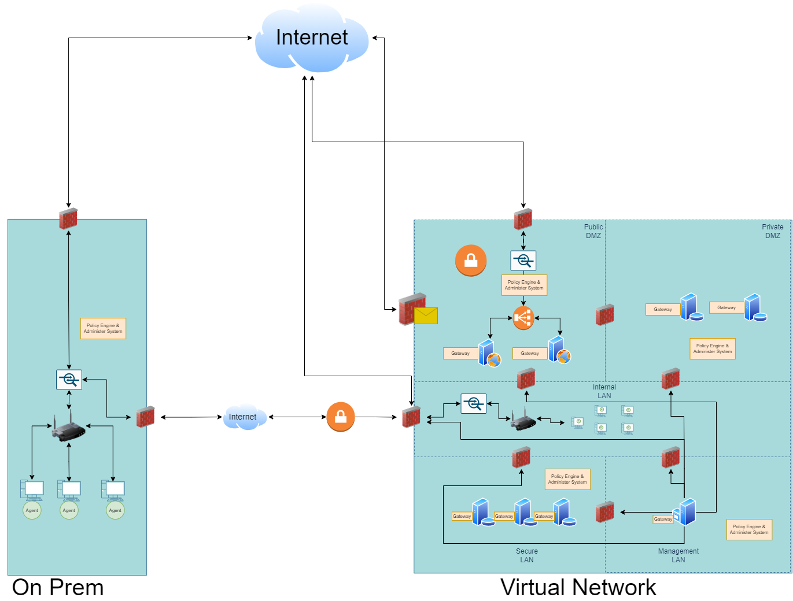

Slide 41
4.2 Modern Architecture vs. Zero Trust
Traditional Secure Network Architecture:
Perimeter-Based Security:
Trust is established once inside the network.
Emphasis on strong external defenses, with less rigorous internal controls.
Network Segmentation:
Basic segmentation typically includes public and private DMZs, along with internal and management LANs.
Access controls within the network can be less strict, assuming internal traffic is more trustworthy.
Device Trust:
Devices inside the network are generally trusted.
There's a clear distinction between company-managed (trusted) devices and others.
Identity and Access Management:
User identity verification might be less stringent within the internal network.
Often relies on single-factor or less robust multi-factor authentication methods.
Data Protection:
Data security focused on perimeter defense; once inside the perimeter, data is less protected.
Encryption may not be uniformly enforced internally.
Application Security:
Applications within the internal network might have implicit trust and easier access.
Infrastructure Management:
Centralized management with emphasis on protecting critical infrastructure components.
Limited micro-segmentation and often relies on traditional firewall rules.

Slide 42
Zero Trust Network Architecture:
Never Trust, Always Verify:
Trust is never assumed, regardless of location; verification is required for every access request.
Emphasis is on continuous authentication and authorization for all users and devices.
Granular Network Segmentation:
Extensive micro-segmentation down to the individual workload level.
Strict access controls are enforced throughout the network, not just at the perimeter.
Device Posture Check:
All devices are treated as potentially hostile. Compliance and security posture are continually assessed.
There's no distinction between internal and external devices in terms of trust.
Identity and Access Management (IAM):
Strong IAM controls are in place with multi-factor authentication as a standard for all users, both on-premises and remote.
Dynamic access controls that can adjust permissions based on the context of the access request.
Data-Centric Security:
Data is protected throughout the network with encryption, both at rest and in transit.
Access to data is tightly controlled based on user roles and the sensitivity of the data.
Application-Level Security:
Applications must authenticate and sessions are continuously monitored.
Access to applications is based on user identity and context.
Infrastructure as Code (IaC):
The infrastructure is managed as code, allowing for consistent, repeatable, and secure deployments.
Enhanced visibility and control over infrastructure components, with the ability to respond quickly to changes or threats.

